Slide 1






Hospital Management
Case Study
-Saikumar Mehtre

Slide 2




Introduction
The Hospital Management System is designed to streamline and organize hospital operations effectively.
This system manages various aspects, such as patient records, doctor details, appointments, treatments, medications, wards, and staff information.
It is built on a relational database model, leveraging SQL to query, analyze, and maintain data

Slide 3

Objectives
To provide a structured and efficient solution for managing hospital workflows. To ensure seamless integration of various entities, enabling smooth coordination among hospital departments.

Slide 4
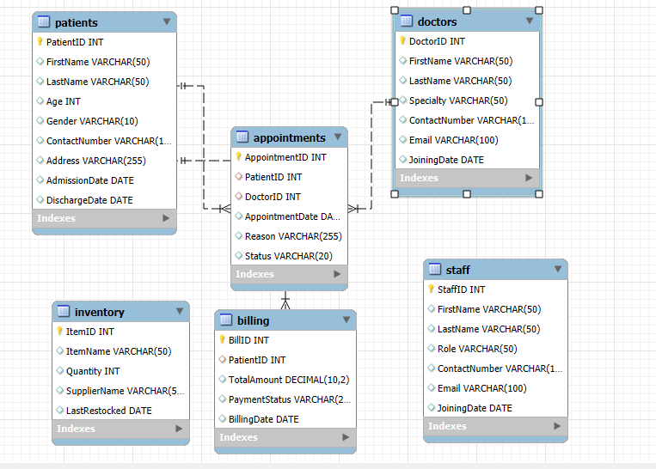
ENTITY RELATIONSHIP DIAGRAM

Slide 5


Queries
&
Solutions

Slide 6


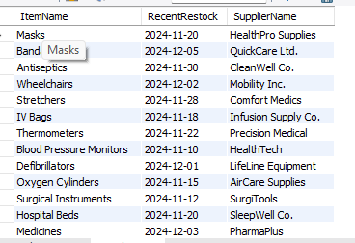
Q1) Find the most recent restocked date for each inventory item, along with the supplier name.
This SQL query uses a `GROUP BY` clause on `ItemName` and `SupplierName` to find the maximum (most recent) `LastRestocked` date, aliased as `RecentRestock`, for each distinct combination of item and supplier from the `Inventory` table.

Slide 7

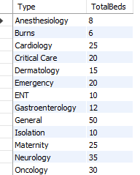
Q2) Get the total number of beds in each ward type, sorted by the ward name.
This SQL query uses a `GROUP BY` clause on the `Type` column of the `Wards` table to calculate the `SUM` of the `Capacity` (aliased as `TotalBeds`) for each ward type, and then orders the results by the `Type` column using an `ORDER BY` clause.

Slide 8


Q3) Retrieve details of all patients who were discharged in December 2024.
This SQL query selects `PatientID`, `FirstName`, `LastName`, `AdmissionDate`, and `DischargeDate` from the `Patients` table, filtering records using a `WHERE` clause to retrieve only patients whose `DischargeDate` falls within December 2024 (month 12, year 2024).

Slide 9

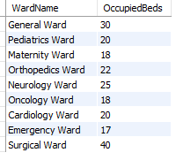
Q4) Find the wards with more than 15 occupied beds.
SQL query selects the `WardName` and `OccupiedBeds` from the `Wards` table, filtering the results with a `WHERE` clause to only include wards where `OccupiedBeds` is greater than 15.

Slide 10

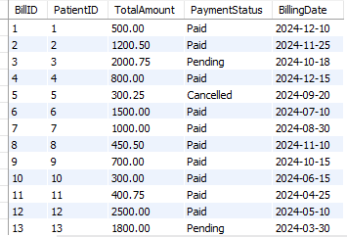
Q5) Update the payment status of patients discharged in November 2024 to 'Paid' if their status is currently 'Pending’.
The query performs an UPDATE on the `Billing` table by joining with the `Patients` table, setting `PaymentStatus` to ‘Paid’ where `DischargeDate` falls in November 2024 and the current `PaymentStatus` is 'Pending'.

Slide 11


Q6) Find all patients who have pending bills, along with their total bill amount and payment status.
The query retrieves “patient names (FirstName, LastName) from the `Patients` table” and “billing details (TotalAmount, PaymentStatus) from the `Billing` table” by performing a “JOIN on PatientID”, filtering records with “`PaymentStatus = 'Pending’`”.

Slide 12

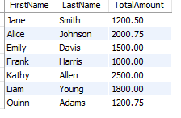
Q7) Retrieve the patient details for those whose bill amount exceeds the average bill amount.
The query retrieves “patient details (FirstName, LastName, TotalAmount)” by joining the `Patients` and `Billing` tables, filtering patients whose “`TotalAmount` exceeds the average bill amount” calculated from the `Billing` table.

Slide 13

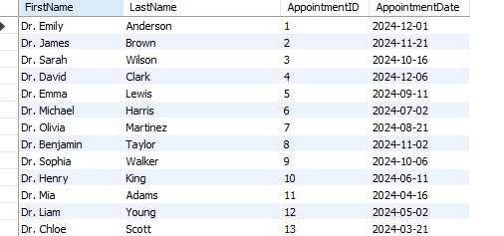
Q8) List all appointments with doctor names and appointment date
This SQL query uses an inner join to retrieve appointment details (ID and date) along with the corresponding doctor's first and last name by matching DoctorID between the Appointments and Doctors tables.

Slide 14
Q9) Update the payment status of patients discharged in November 2024 to 'Paid' if their status is currently 'Pending'.
This SQL `UPDATE` statement, using an `JOIN` with the `Patients` table, sets the `PaymentStatus` column in the `Billing` table to 'Paid' where the `DischargeDate` from the joined `Patients` table is in November 2024 (month 11, year 2024) and the `PaymentStatus` in the `Billing` table is currently 'Pending'.

Slide 15

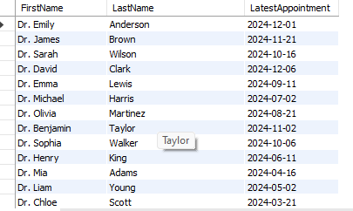
Q10) Find the latest appointment for each doctor.
This SQL query uses an `INNER JOIN` between the `Doctors` and `Appointments` tables and a `GROUP BY` clause on `DoctorID` to select each doctor's first and last name along with the maximum (latest) `AppointmentDate` aliased as `LatestAppointment`.

Slide 16
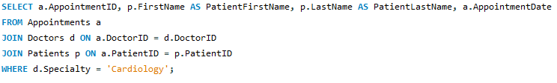

Q11) List all appointments scheduled for a doctor specializing in 'Cardiology'.
This SQL query uses `INNER JOIN`s on `DoctorID` and `PatientID` to retrieve `AppointmentID`, patient's first and last names, and `AppointmentDate` from the `Appointments`, `Doctors`, and `Patients` tables, filtering for doctors with the `Specialty` 'Cardiology' using a `WHERE` clause.

Slide 17
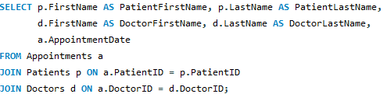
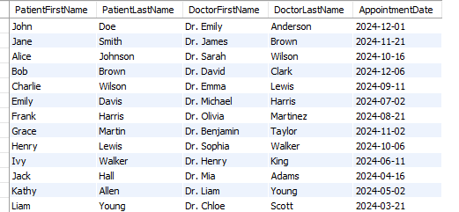
Q12) List the names of patients along with their assigned doctor's name and the appointment date.
This SQL query uses two `INNER JOIN` clauses to combine data from the `Appointments`, `Patients`, and `Doctors` tables, retrieving patient and doctor names along with the appointment date by matching `PatientID` and `DoctorID` across the tables.

Slide 18
Thank
You

